Slide 1
MIPS ISA: Procedure Calls
Chapter 3

Slide 2
Review
MIPS basic instructions
  Arithmetic instructions: add, addi, sub
  Data transfer instructions: lw, sw, lb, sb
  Control instructions: bne, beq, j, slt, slti
  Logical operations: and, andi, or, ori, nor, sll, srl
Important principles in ISA and hardware design
  Simplicity favors regularity
  Smaller is faster
  Make the common case fast
  Good design demands good compromises
  Stored program concept
Procedures
Notes:
Operate on bits individually, unlike arithmetic, which operate on entire word.
Use to isolate fields, either by masking or by shifting back and forth.
sll: Does it signal overflow?
Answer: Nope, the bits are “lost” over the left side!

Slide 3
Review
MIPS instruction format
  Stored program concept: every instruction is a 32-bit binary number
  R-format, I-format, J-format
Encoding/decoding assembly/machine code
  Disassembly starts with opcode
  Pseduoinstructions are introduced
Name
Fields
Comments
Field size
6 bits
5 bits
5 bits
5 bits
5 bits
6 bits
All MIPS instructions 32 bits
R-format
op
rs
rt
rd
shamt
funct
Arithmetic instruction format
I-format
op
rs
rt
address/immediate
Transfer, branch, imm. format
J-format
op
target address
Jump instruction format
Procedures

Slide 4
Outline
More MIPS ISA
  How to transfer control in response to procedure calls and returns
  How to propagate data between procedures
  How to safely share hardware resource among multiple procedures
Other ISA brief introduction
Procedures

Slide 5
C Functions
main() {
int i,j,k,m;
...
i = mult(j,k); ...
m = mult(i,i); ...
}
/* really dumb mult function */
int mult (int mcand, int mlier){
int product;
product = 0;
while (mlier > 0) {
product = product + mcand;
mlier = mlier -1; }
return product;
}
What MIPS instructions can accomplish this?
What information must compiler or programmer keep track of?
Procedures

Slide 6
Procedure Calls
main() {
int i,j,k,m;
...
i = mult(j,k); ...
m = mult(i,i); ...
}
Control flow
  Caller → callee → caller: need to know where to return
Data flow
  Caller → callee: parameters
  Callee → caller: return value
Shared resources
  memory, register
What information must compiler or programmer keep track of?
Procedures

Slide 7
Function Call Bookkeeping
Registers play a major role in keeping track of information for function calls
Register conventions in MIPS
  Return address: $ra
  Arguments: $a0, $a1, $a2, $a3
  Return value: $v0, $v1
  Local variables: $s0, $s1, … , $s7
The stack is also used; more later
Procedures

Slide 8
Translation of Procedures
...
sum(a,b); /* a,b:$s0,$s1 */
...
}
int sum(int x, int y) {
return x+y;
}
address
1000
1004
1008
1012
1016
2000
2004
C
MIPS
In MIPS, all instructions are 4 bytes, and stored in memory just like data; So here we show the addresses of where the programs are stored
Procedures

Slide 9
Translation of Procedures
...
sum(a,b); /* a,b:$s0,$s1 */
...
}
int sum(int x, int y) {
return x+y;
}
address
1000 add $a0,$s0,$zero # x=a
1004 add $a1,$s1,$zero # y=b
1008 addi $ra,$zero,1016 #$ra=1016
1012 j sum #jump to sum
1016 ...
2000 sum: add $v0,$a0,$a1
2004 jr $ra # new instruction
C
MIPS
Procedures

Slide 10
Translation of Procedures
...
sum(a,b); /* a,b:$s0,$s1 */
...
}
int sum(int x, int y) {
return x+y;
}
Question: why use jr+$ra here? Why not simply use j?
Answer: sum might be called by many functions, so we can NOT return to a fixed place
  The caller to sum must be able to say “return here” somehow
2000 sum: add $v0,$a0,$a1
2004 jr $ra # new instruction
C
Procedures

Slide 11
Instruction Support for Procedures
Syntax for jr (jump register):
  jr register
Instead of providing a label to jump to, the jr instruction provides a register which contains an address to jump to
  Only useful if we know the exact address to jump to
  The register covers the complete 32-bit address space
  Instruction jr $ra is commonly used as the exit from the callee where $ra is the designated register for return address
    Caller need to set the value of $ra
Procedures

Slide 12
Instruction Support for Procedures
In the previous example:
1008 addi $ra,$zero,1016 #$ra=1016
1012 j sum #goto sum
A new instruction is introduced: jal
  Jump and link
  A single instruction to jump and save return address
New translation
1008 jal sum # $ra=1012,goto sum
Advantages
  Make the common case fast: function calls are very common
  You don’t have to know where the code is loaded into memory with jal
Procedures

Slide 13
Instruction Support for Procedures
Syntax for jal (jump and link) is same as for j(jump):
  jal label
_x001d_ jal should really be called “laj” for “link and jump”:
  Step 1 (link): Save address of next instruction into $ra (Why next instruction? Why not current one?)
  Step 2 (jump): Jump to the given label
Procedures

Slide 14
Nested Procedures
Example
int sumSquare(int x, int y) {
return mult(x,x)+ y;
}
  Some caller invokes sumSquare(), now sumSquare() need to call mult()
Problem?
  Special register $ra shared by all procedures: There is a value in $ra that sumSquare() wants to jump back to, but this will be overwritten by the call to mult()
Solution: Need to save old $ra(return address for sumSquare) before the call to mult()
Procedures

Slide 15
Nested Procedures
In general, may need to save some other information in addition to $ra
  E.g. argument registers
  Memory is where to store these information
When a C program is running, there are 3 important memory areas allocated:
  Static: Variables declared once per program, cease to exist only after execution completes
    E.g., C globals
  Heap: Variables declared dynamically
    E.g., malloc
  Stack: Space to be used by procedure during execution; this is where we keep local/temp variables and save register values
Procedures

Slide 16
Memory Allocation
max
Space for saved
procedure information
Stack
$sp
stack
pointer
Explicitly created space,
e.g., malloc();
Heap
Variables declared
once per program
Static
Address
Code
Program
0
Procedures
Notes:
Intel processors, stacks grow down; Decsystem-20’s stack grows up

Slide 17
Using the Stack
So we have a register $sp which always points to the last used space in the stack
  Can be used as the base address to specify a memory location
To use stack, we decrement $sp pointer by the amount of space we need and then fill it with info
  Assuming stack grows downwards in our discussion
For each procedure invocation, a segment of memory is allocated to keep the necessary info
  Called activation record or procedure frame
  Frame pointer ($fp): first word of the frame
  Stack will grow and shrink along with procedure calls and returns: push or pop
Procedures

Slide 18
Using the Stack
MIPS:
sumSquare:
addi $sp,$sp,-8 # space on stack
sw $ra, 4($sp) # save ret addr
sw $a1, 0($sp) # save y
add $a1,$a0,$zero # pass x as the 2nd arg
jal mult # call mult
lw $a1, 0($sp) # restore y
add $v0,$v0,$a1 # mult()+y
lw $ra, 4($sp) # get ret addr
addi $sp,$sp,8 # restore stack
jr $ra
mult: ...
  int sumSquare(int x, int y) {
  return mult(x,x)+ y; }
Stack “push”
Stack “pop”
Note: $fp update not shown here
Procedures
Notes:
$fp update not included
Hand-drawing to show the stack grow and shrink

Slide 19
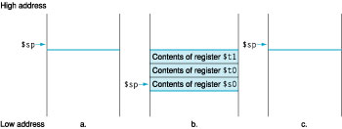
Stack Allocation
Caller’s frame
Caller’s frame
before during after
function call function call function call
Procedures

Slide 20
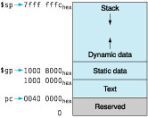
Why Stack?
Allocate a frame for each procedure on memory is intuitive
  But why maintain that part of memory as a stack?
  Why not static?
Modern programming languages are recursive
  Need one unique frame for each invocation
  Example: factorial calculation
Procedures

Slide 21
Steps for Making a Procedure Call
1) Save necessary values into stack
  Return address, arguments, …
2) Assign argument(s), if any
  Special registers
3) jal call
  Control transferred to callee after executing this instruction
4) Restore values from stack after return from callee
Prolog
Epilog
Procedures

Slide 22
MIPS Registers
Uses Number Name
Constant 0 $0 $zero
Reserved for Assembler $1 $at
Return Values $2-$3 $v0-$v1
Arguments $4-$7 $a0-$a3
Temporary $8-$15 $t0-$t7
Saved $16-$23 $s0-$s7
More Temporary $24-$25 $t8-$t9
Used by Kernel $26-27 $k0-$k1
Global Pointer $28 $gp
Stack Pointer $29 $sp
Frame Pointer $30 $fp
Return Address $31 $ra
Procedures

Slide 23
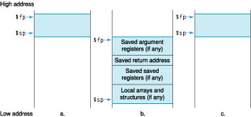
Argument Registers
Only four of them reserved in the register set
  What to do if we have more arguments to pass?
MIPS convention is to place extra parameters on the stack just above the frame pointer
Procedures

Slide 24
Register Conventions
CalleR: the calling function
CalleE: the function being called
Caller and callee share the same set of temporary registers ($t0-$t9) and local variable registers ($s0-$s7$): conflict?
  When callee returns from executing, the caller needs to know which registers may have changed and which are guaranteed to be unchanged
Register conventions
  A set of generally accepted rules as to which registers will be unchanged after a procedure call (jal) and which may be changed
Procedures

Slide 25
Callee’s Rights
Callee’s rights:
  Right to use VAT registers freely
    V - return value
    A - argument
    T - temporary
  Right to assume arguments are passed correctly
To ensure callees’s right, caller saves registers:
  Return address $ra
  Arguments $a0, $a1, $a2, $a3
  Return value $v0, $v1
  $t Registers $t0 - $t9
Procedures

Slide 26
Caller’s Rights
Caller’s rights:
  Right to use S registers without fear of being overwritten by callee
  Right to assume stack pointer remains the same across procedure calls
  Right to assume return value will be returned correctly
To ensure caller’s right, callee saves registers:
  $s Registers $s0 - $s7
  Stack pointer register $sp
  Restore if you change: If the callee changes these in any way, it must restore the original values before returning
  They are called saved registers
Procedures

Slide 27
Register Conventions
What do these conventions mean?
  If function R calls function E, then function R must save any temporary registers that it may be using into the stack before making a jal call
  Function E must save any S (saved) registers it intends to use before garbling up their values
  Remember: Caller/callee need to save only temporary/saved registers they are using, not all registers
Procedures

Slide 28
Analogy: Home-Alone Weekend
Parents (main) leaving for weekend
They (caller) give keys to the house to kid (callee) with the rules (calling conventions):
  You can trash the temporary room(s), like the den and basement (t registers) if you want, we don’t care about it
  BUT you’d better leave the rooms (s registers) that we want to save for the guests untouched: “these rooms better look the same when we return!”
Who hasn’t heard this in their life?
Procedures

Slide 29
Analogy: Home-Alone Weekend
Kid now “owns” rooms (t registers)
Kid wants to use the saved rooms for a wild, wild party (computation)
What does kid (callee) do?
  Kid takes what was in these rooms and puts them in the garage (memory)
  Kid throws the party, trashes everything (except garage, who goes there?)
  Kid restores the rooms the parents wanted saved after the party by replacing the items from the garage (memory) back into those saved rooms
Procedures

Slide 30
Analogy: Home-Alone Weekend
Same scenario, except before parents return and kid replaces saved rooms…
Kid (callee) has left valuable stuff (data) all over
  Kid’s friend (another callee) wants the house for a party when the kid is away
  Kid knows that friend might trash the place destroying valuable stuff!
  Kid remembers rule parents taught and now becomes the “heavy” (caller), instructing friend (callee) on good rules (conventions) of house
Procedures

Slide 31
Analogy: Home-Alone Weekend
If kid had data in temporary rooms (which were going to be trashed), there are three options:
  Move items directly to garage (memory)
  Move items to saved rooms whose contents have already been moved to the garage (memory)
  Optimize lifestyle (code) so that the amount you’ve got to ship stuff back and forth from garage (memory) is minimized
Otherwise: “Dude, where’s my data?!”
Procedures

Slide 32
Analogy: Home-Alone Weekend
Friend now “owns” rooms (registers)
Friend wants to use the saved rooms for a wild, wild party (computation)
What does friend (callee) do?
  Friend takes what was in these rooms and puts them in the garage (memory)
  Friend throws the party, trashes everything (except garage)
  Friend restores the rooms the kid wanted saved after the party by replacing the items from the garage (memory) back into those saved rooms
Procedures

Slide 33
Recap
Register conventions
  Each register has a purpose and limits to its usage
  Learn these and follow them, even if you’re writing all the code yourself
For nested calls, we need to save the argument registers if they will be modified
  Save to stack
  Save to $sx registers – arguments can be treated as local variables
Procedures

Slide 34
Example – Factorial Computation
Int fact (int n) {
If (n<1) return (1);
Else return (n*fact(n-1));
}
Assembly code
Stack behavior
Remark:
  This is a recursive procedure
Procedures

Slide 35
Example – Factorial Computation
Register Assignment:
  $a0 ⬅ argument n-1
  Since n will be needed after the recursive procedure call, $a0 needs to be saved
    We move $a0 to $s0, the callee will save the value if necessary
  $v0 ⬅ returned value
  Other registers need to be saved: $ra
int fact (int n) {
if (n<1) return (1);
else return (n*fact(n-1));
}
fact: addi $sp, $sp, -8
sw $s0, 0($sp)
sw $ra, 4($sp)
move $s0, $a0
… procedure body …
exit: lw $ra, 4($sp)
lw $s0, 0($sp)
addi $sp, $sp, 8
jr $ra
Procedures

Slide 36
Example – Factorial Computation
Procedure body
  Exit condition
  Recursion
int fact (int n) {
if (n<1) return (1);
else return (n*fact(n-1));
}
slti $t0, $s0, 1
beq $t0, $zero, recursion
addi $v0, $zero, 1
j exit
recursion:
addi $a0, $a0, -1
jal fact
mul $v0, $v0, $s0
j exit
Procedures

Slide 37
Example – Factorial Computation
Stack contents during the execution of fact(2)
$ra
$ra
$ra
$ra
$ra
$sp➔
$s0 = 0
$s0 = 0
$s0 = 0
$s0 = 0
$sp➔
$s0 = 0
$ra
$ra
$ra
$sp➔
$s0 = 2
$s0 = 2
$sp➔
$s0 = 2
$ra
$sp➔
$s0 = 1
fact(2) fact(1) fact(0)
Suppose $s0=0 before fact(2)
Procedures

Slide 38
Alternative Architectures
Design alternative:
  Provide more powerful operations
  Goal is to reduce number of instructions executed
  Danger is a slower cycle time and/or a higher CPI
Let’s look (briefly) at IA-32
Procedures

Slide 39
IA-32
1978: Intel 8086 is announced (16 bit architecture)
1980: 8087 floating point coprocessor is added
1982: 80286 increases address space to 24 bits, +instructions
1985: 80386 extends to 32 bits, new addressing modes
1989-1995: 80486, Pentium, Pentium Pro add a few instructions (mostly designed for higher performance)
1997: 57 new “MMX” instructions are added, Pentium II
1999: Pentium III added another 70 instructions (SSE)
Procedures
Notes:
MMX:Multi Media Extension
SSE: Streaming SIMD extensions. Add 8 registers. Each with 128 bits. Hence, 32-bit operations can be run in parallel.

Slide 40
IA-32
2001: Another 144 instructions (SSE2)
2003: AMD extends to increase address space to 64 bits, widens all registers to 64 bits and other changes (AMD64)
2004: Intel capitulates and embraces AMD64 (calls it EM64T) and adds more media extensions
This history illustrates the impact of the “golden handcuffs” of compatibility
  “adding new features as someone might add clothing to a packed bag”
  “an architecture that is difficult to explain and impossible to love”
Procedures
Notes:
MMX:Multi Media Extension
SSE: Streaming SIMD extensions. Add 8 registers. Each with 128 bits. Hence, 32-bit operations can be run in parallel.

Slide 41
IA-32 Overview
Complexity:
  Instructions from 1 to 17 bytes long
  One operand must act as both a source and destination
    E.g. add eax, ebx ;EAX = EAX+EBX
  One operand can come from memory
  Complex addressing modes
    E.g., “base plus scaled index with 8 or 32 bit displacement”=base+(2^{scale}×index) + displacement
Saving grace:
  The most frequently used instructions are not too difficult to build
  Compilers avoid the portions of the architecture that are slow
Procedures

Slide 42
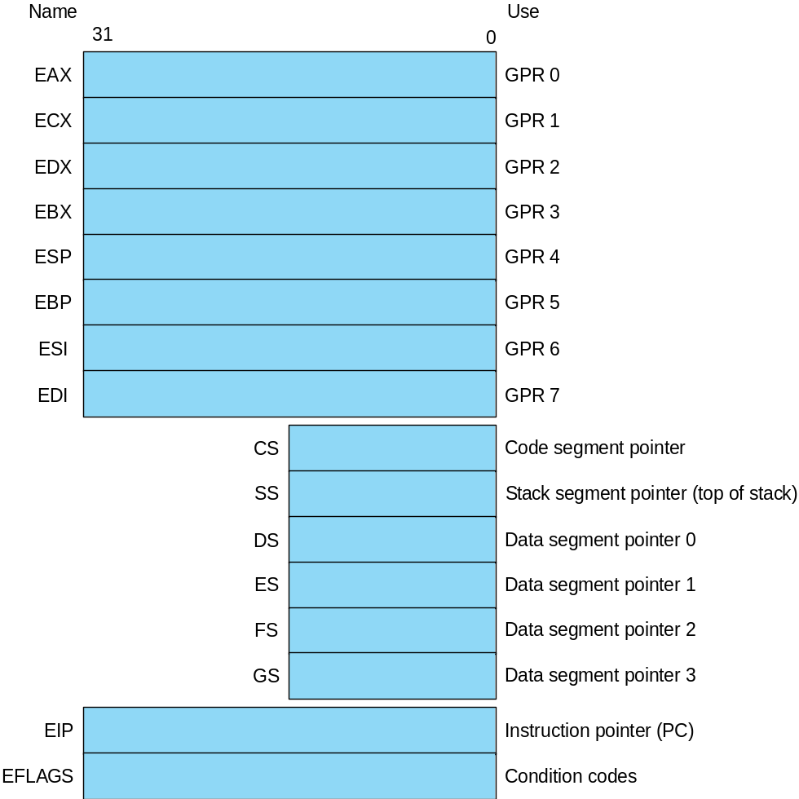
IA-32 Registers
Registers in 32-bit subset that originated with 80386
Fig. 2.40
Procedures

Slide 43
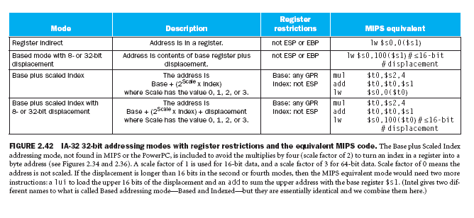
IA-32 Data Addressing
Registers are not really “general purpose” – note the restrictions below
Fig. 2.42
Procedures

Slide 44
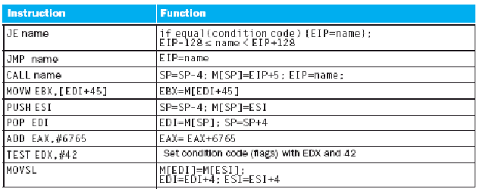
IA-32 Typical Instructions
Four major types of integer instructions:
  Data movement including move, push, pop
  Arithmetic and logical (destination register or memory)
  Control flow (use of condition codes / flags )
  String instructions, including string move and compare
Fig. 2.43
Procedures

Slide 45
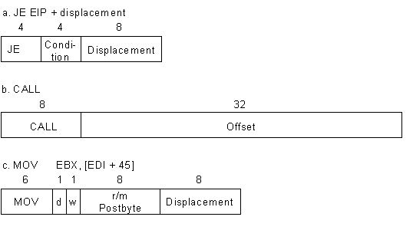
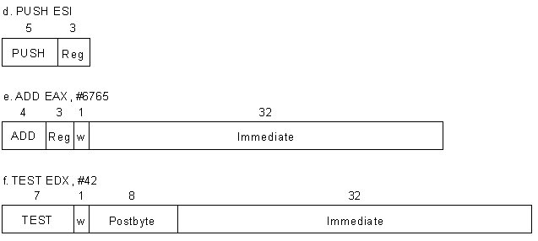
IA-32 instruction Formats
Typical formats: (notice the different lengths)
Fig. 2.45
Procedures

Slide 46
MIPS versus IA-32
Fixed instruction formats of MIPS
  Simple decoding logic
  Waste of memory space
  Limited addressing modes
Variable length formats of IA-32
  Difficult to decode
  Compact machine code
  Accommodate versatile addressing modes
Procedures

Slide 47
MIPS versus IA-32
Large pool of general-purpose registers in MIPS
  Generally no special considerations for particular opcodes
  Simplify programming and program optimizations
  Good for compilations
Small pool of register in IA-32
  Small amount of data stored inside CPU
    Usually lead to inefficient code
  Many registers serve special purposes; making programmer/compiler’s job difficult
    Again could lead to inefficient code
Procedures

Slide 48
MIPS versus IA-32
Operand architecture of MIPS
  Three register operands
  Data must be explicitly moved into registers and stored back before and after computation
  Creates longer machine code but reflects the reality
Operands architecture of IA-32
  One or two operands
  Operands in some instructions are fixed and implied
    Compact code but lack flexibilities; optimization difficult
  One operand can be memory
    No explicit load/stores; compact code
    No gain in performance: data are moved in/out CPU anyway
Procedures

Slide 49
IA-32 Overall
IA-32 has to backward compatible with previous 8/16 bit architectures
  This contributes to its complexities, many of which unnecessarily so
  However, Intel gets to keep its software and customer base: BIG PLUS
  Intel commands huge resources to push improvements
  The result is IA-32 chips are generally on par with other modern ISAs
Procedures

Slide 50
Summary
More MIPS ISA: procedure calls
  Instruction: jal, jr
  Register: $a0-$a4, $v0-$v1, $ra, $sp, $fp
  Memory: activation record (frame) stack
  Procedure call steps
  Register conventions
IA-32 brief introduction
  Basic features: instruction set, format, register set
  Comparison with MIPS
Procedures

Slide 51
Exercise
Translate into MIPS
  swap (int v[], int k) { /* v[] as the base address of array v */
  int temp;
  temp = v[k]; /* swap memory content of v[k]
  and v[k+1] */
  v[k] = v[k+1];
  v[k+1] = temp;
  }
Procedures

Slide 52
Exercise- Key
swap:
sll $t1, $a0, 2
add $t1, $t1, $a1
lw $t0, 0($t1)
lw $t2, 4($t1)
sw $t2, 0($t1)
sw $t0, 4($t1)
jr $ra
Procedures

Slide 53
Exercise
Translate into MIPS
dummySwap (int v[], int n) {
swap(v,n-1);
swap(v,n-2);
}
Procedures

Slide 54
Exercise - Key
dummySwap:
addi $sp, $sp, -8
sw $s0, 0($sp)
sw $ra, 4($sp)
move $s0, $a1
addi $a1, $a1, -1
jal swap
addi $a1, $s0, -2
jal swap
lw $ra, 4($sp)
lw $s0, 0($sp)
addi $sp, $sp, 8
jr $ra
Procedures

Slide 55
Example – swap Procedure (1/2)
swap (int v[], int k) {
int temp;
temp = v[k];
v[k] = v[k+1];
v[k+1] = temp;
}
Given assembly code
Study stack behavior
Procedures

Slide 56
Example – swap Procedure (2/2)
swap:
add $t0, $a1, $a1
add $t0, $t0, $t0
add $t0, $t0, $a0
lw $t1, 0($t0)
lw $t2, 4($t0)
sw $t2, 0($t0)
sw $t1, 4($t0)
jr $ra
Register assignment:
  $a0 ⬅ base address v of the integer array
  $a1 ⬅ index k
  $t0 ⬅ local variable temp
  No stack operation.
swap (int v[], int k) {
int temp;
temp = v[k];
v[k] = v[k+1];
v[k+1] = temp;
}
Procedures

Slide 57
Example – Bubble Sort (1/4)
sort (int v[], int n) {
int i, j;
for (i=1; i<n; i++) {
for (j=I-1; j>=0 && v[j]>v[j+1]; j--) {
swap(v,j);
}
}
}
Given assembly code
Analyze stack behavior – very simple
Procedures

Slide 58
Example – Bubble Sort (2/4)
Register assignment:
  $a0 ⬅ base address of integer array v
  $a1 ⬅ length n of the array
  $s0 ⬅ local variable i
  $s1 ⬅ local variable j
  Registers need to be saved: $s0, $s1, $ra, $a1, more? Why?
bubbleSort:
addi $sp, $sp, -16
sw $s0, 0($sp)
sw $s1, 4($SP)
sw $s2, 8($sp)
sw $ra, 12($sp)
move $s2, $a1
… procedure body …
exit:
lw $ra, 12($sp)
lw $s2, 12($sp)
lw $s1, 4($sp)
lw $s0, 0($sp)
addi $sp, $sp, 16
jr $ra
sort (int v[], int n) {
int i, j;
for (i=1; i<n; i++) {
for (j=I-1; j>=0 &&
v[j]>v[j+1]; j--) {
swap(v,j);
}
}
}

Slide 59
Example – Bubble Sort (3/4)
The loop for index I
for (i=1; i<n; i++) {
… … … … …
}
li $s0, 1
for_i:
slt $t0, $s0, $s2
beq $t0, $zero, exit
… the loop indexed by j …
exit_j: addi $s0, $s0, 1
j for_i
Procedures

Slide 60
Example – Bubble Sort (4/4)
The loop for index j
for (j=I-1; j>=0 &&
v[j]>v[j+1]; j--) {
swap(v,j);
}
addi $s1, $s0, -1
for_j:
slt $t0, $s1, $zero
bne $t0, $zero, exit_j
add $t0, $s1, $s1
add $t0, $t0, $t0
add $t0, $t0, $a0
lw $t1, 0($t0)
lw $t2, 4($t0)
slt $t0, $t2, $t1
beq $t0, $zero, exit_j
move $a1, $s1
jal swap
addi $s1, $s1, -1
j for_j
Procedures

Slide 61
What Happens at a Procedure Call
Before “jal”, caller does the following
  Put arguments to be passed into $4 -- $7, and stack
  Save any “caller-saved” registers
  Adjust $sp if necessary
At the beginning of a procedure, callee does the following
  Setup new frame pointer
  Save “callee-saved” registers ($ra, etc.)
  Setup $sp
  Adjust $sp if necessary
Before “jr $ra”, callee does the following
  Put return values in $2, $3
  Restore any saved registers
  Adjust $sp if necessary
After “jr”, caller does the following
  Restore any saved registers
  Adjust $sp

Slide 62
Procedure Call Frame (Option)
Procedure call frame: a block of memory within stack to
  save registers:
    registers that a procedure may modify but that which the procedure’s caller does not want them to be changed
  provide space for variables and structures local to a procedure
It is unique for each procedure.
$fp is fixed for each procedure. It can be used to make relative addressing easier
Higher memory address
– $fp points to the first word in the currently executing procedure’s stack frame; $sp points to the last word of the frame.
– follow the calling conventions!
– SPIM simulator does not use $fp
– Not all MIPS compiler uses $fp.
– when $fp is not used, it is replaced by register $s8
…
Argument 6
Argument 5
Saved registers
Local variables
$fp
Stack grows
$sp
Lower memory address

Slide 63
MIPS Procedure Handling Summary
Need “jump” and “return”
  jal ProcAddr # issued by the caller
  jumps to ProcAddr
  save the return instruction address (PC+4) in $31
  jr $31 # last instruction in the callee
  jump back to the caller procedure
Need to pass parameters
  Registers $4 -- $7 ($a0 -- $a3) are used to pass first 4 parameters
  Other parameters are passed through stack.
  Returned values are in $2 and $3 ($v0 & $v1)
How about nested procedure?
  Get help from stack!
Procedures

Slide 64
Basic Structure of a Function
Prologue
entry_label:
addi $sp,$sp, -framesize
sw $ra, framesize-4($sp) # save $ra
save other regs if need be
...
restore other regs if need be
lw $ra, framesize-4($sp) # restore $ra
addi $sp,$sp, framesize
jr $ra
ra
Body (call other functions…)
Epilogue
memory
Procedures

Slide 65
Rules for Procedures
Called with a jal instruction, returns with a jr $ra
Accepts up to 4 arguments in $a0, $a1, $a2 and $a3
Return value is always in $v0 (and if necessary in $v1)
Must follow register conventions (even in functions that only you will call)! So what are they?
Procedures

Slide 66
Reserved/Special Registers
$at: may be used by the assembler at any time; unsafe to use
$k0-$k1: may be used by the OS at any time; unsafe to use
$gp, $fp: don’t worry about them
Note: Feel free to read up on $gp and $fp in Appendix A, but you can write perfectly good MIPS code without them.
Procedures

Slide 67
Register Conventions (2/4) - saved
$0: No Change. Always 0.
$s0-$s7: Restore if you change. Very important, that’s why they’re called saved registers. If the callee changes these in any way, it must restore the original values before returning.
$sp: Restore if you change. The stack pointer must point to the same place before and after the jal call, or else the caller won’t be able to restore values from the stack.
HINT -- All saved registers start with S!
Procedures

Slide 68
Register Conventions (3/4) - volatile
$ra: Can Change. The jal call itself will change this register. Caller needs to save on stack if nested call.
$v0-$v1: Can Change. These will contain the new returned values.
$a0-$a3: Can change. These are volatile argument registers. Caller needs to save if they’ll need them after the call.
$t0-$t9: Can change. That’s why they’re called temporary: any procedure may change them at any time. Caller needs to save if they’ll need them afterwards.
Procedures

Slide 69
Fallacies
Powerful instruction ⇒ higher performance
  Fewer instructions required
  But complex instructions are hard to implement
    May slow down all instructions, including simple ones
  Compilers are good at making fast code from simple instructions
Use assembly code for high performance
  But modern compilers are better at dealing with modern processors
  More lines of code ⇒ more errors and less productivity
§2.18 Fallacies and Pitfalls
Procedures

Slide 70
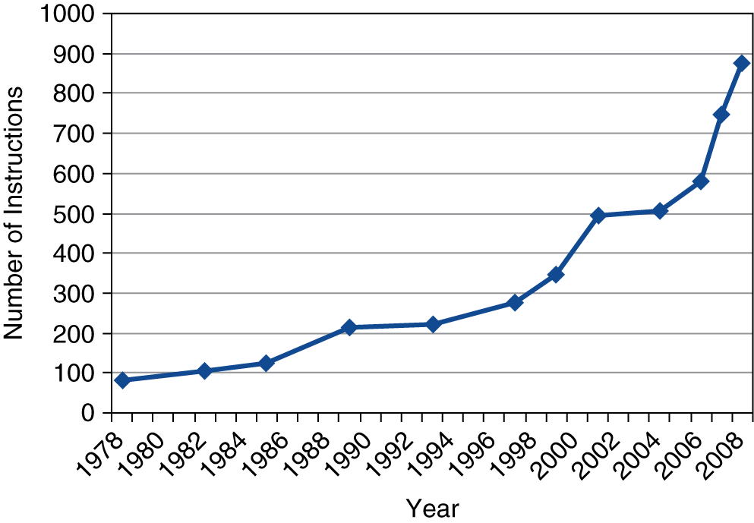
Fallacies
Backward compatibility ⇒ instruction set doesn’t change
  But they do accrete more instructions
x86 instruction set
Procedures

Slide 71
Pitfalls
Sequential words are not at sequential addresses
  Increment by 4, not by 1!
Keeping a pointer to an automatic variable after procedure returns
  e.g., passing pointer back via an argument
  Pointer becomes invalid when stack popped
Procedures

